Slide 1

Online Order Tracking System
Student: Uwimbabazi Sandrine
ID: 27399
Course: Database Development with PL/SQL
Lecturer: Eric Maniraguha
Institution: AUCA
Date: 2025

Slide 2

The Challenge: Inefficient Order Management
1
2
Manual Tracking Headaches
Lost Orders & Errors
Reliance on phone calls and notebooks often results in misplaced orders, incorrect statuses, and a significant drop in customer satisfaction.
Small businesses struggle with manual order updates, leading to inconsistencies and delays that frustrate customers and staff alike.
3
Impacted Users
This problem directly affects Customers seeking transparency, Delivery Staff needing clear instructions, and System Administrators managing operations.

Slide 3
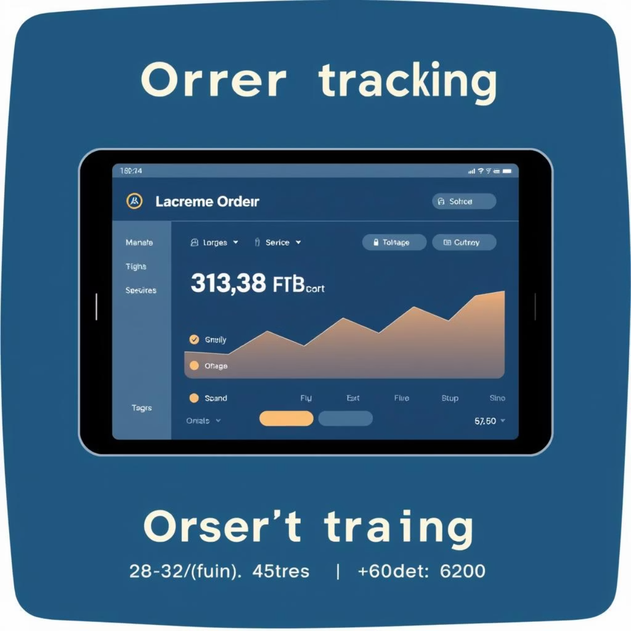
Our Solution: Automated Order Tracking
System Overview
The Online Order Tracking System automates the entire order lifecycle—from recording to delivery confirmation, ensuring seamless and accurate progress.
Key Features
Order Registration & Customer Details: Securely captures essential order and customer information.
Real-time Order Status Tracking: Provides instant updates on order progress for all stakeholders.
Delivery Assignment: Efficiently assigns and manages delivery tasks.
PL/SQL Automation: Utilizes advanced procedures, functions, and triggers for robust data management.
Automatic Reports & Audit Logs: Generates comprehensive reports and maintains detailed audit trails.

Slide 4
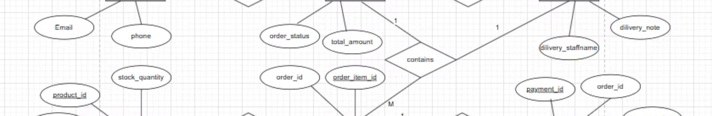
Robust Database Model
Core Entities
Design Principles
Customers: Manages all customer profiles and contact information.
Our database is meticulously designed to ensure data integrity and optimal performance:
Orders: Stores details of each order placed.
Items: Catalogs products or services included in orders.
Normalized to 3NF: Eliminates data redundancy and improves data consistency.
Delivery: Tracks delivery logistics and status.
Staff: Manages delivery personnel and administrators.
Referential Integrity Enforced: Maintains accurate relationships between tables, preventing orphaned records.
Supports Fast Analytics & Reporting: Structured for quick retrieval and analysis of business intelligence.

Slide 5
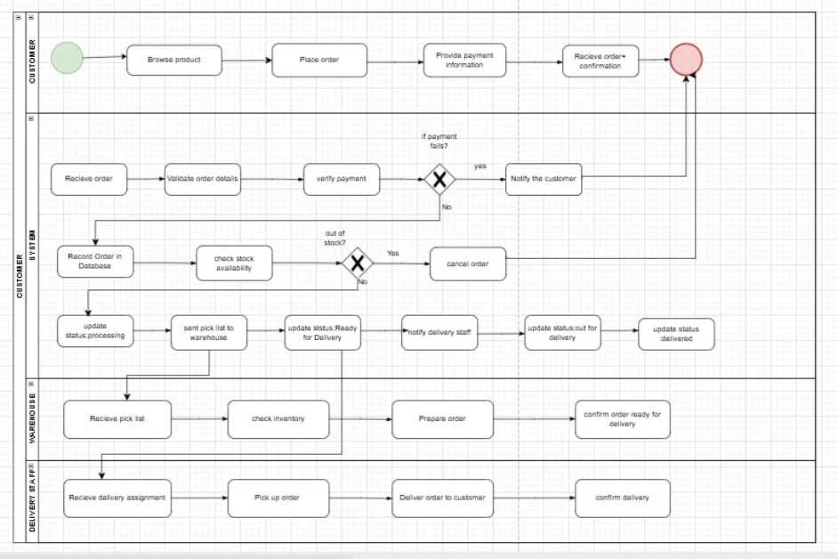

Streamlined Business Process (BPMN)
Customer Places Order
Initiates the process via the online portal or direct entry.
System Validates Items
Ensures stock availability and order accuracy.
Staff Processes Order
Order preparation and packaging are completed by designated staff.
Delivery Assigned
The system dispatches the order to the nearest available delivery personnel.
Tracking Updates Sent
Real-time notifications keep customers informed of delivery progress.
Order Completed
Final confirmation upon successful delivery and customer receipt.

Slide 6
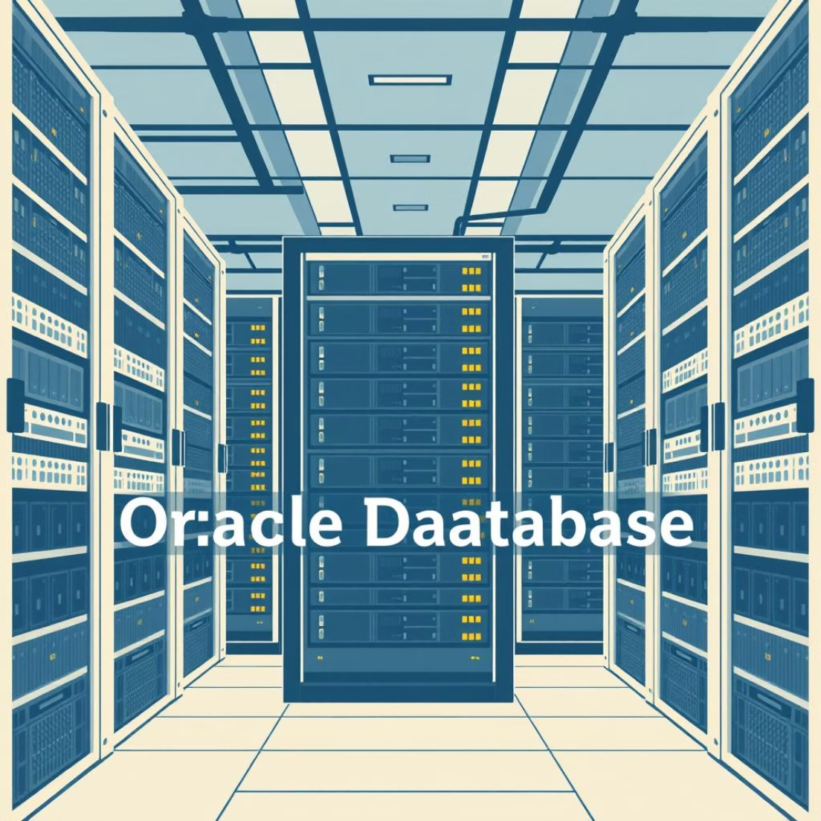

Technical Implementation: Oracle & PL/SQL
Technology Stack
Oracle 21c (PDB, SQL Developer): Leveraging advanced features for robust database management.
PL/SQL: Powers custom business logic and automation.
Functions & Procedures: Modular code for reusable operations.
Packages: Grouping related functions and procedures for better organization.
Triggers: Automating actions based on database events.
Constraints & Indexes: Ensuring data integrity and optimizing query performance.
Core Database Features
Identity Primary Keys
Foreign Keys with Cascading
Automatically generated unique identifiers for each record.
Maintains relationships, cascading updates/deletes across linked tables.
Check Constraints
Unique Indexes
Enforces data rules, ensuring valid entries (e.g., status values).
Guarantees uniqueness of specific columns and speeds up data retrieval.

Slide 7
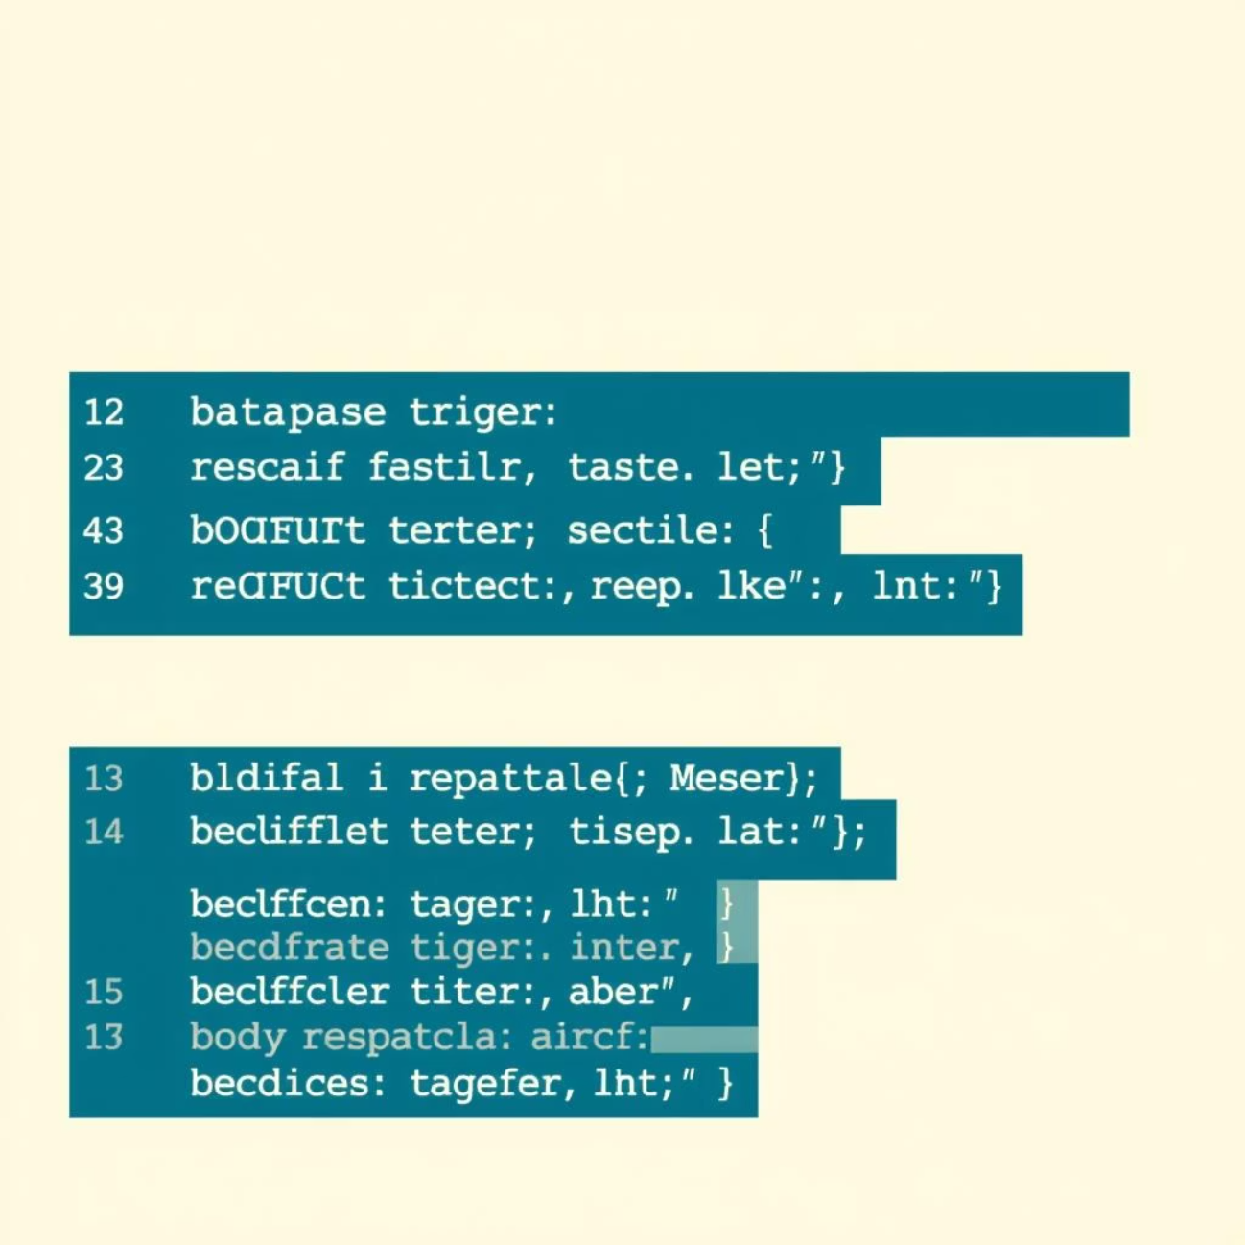

Advanced PL/SQL Features
Automated Triggers
Organized Packages
Order Timestamping: Automatically records order creation and modification times.
Order_Mgmt_Pkg: Centralizes functions for creating, updating, and canceling orders efficiently.
Holiday Update Prevention: Restricts data modifications during non-business periods.
Report_Pkg: Dedicated package for generating daily, weekly, and custom reports.
DML Operation Logging: Comprehensive logging of all data manipulation
language activities for auditing.
Comprehensive Audit Log
Invalid Status Transitions: Prevents orders from moving to illogical statuses.
Records user, action, affected table, success/failure status, and timestamp for full accountability.

Slide 8
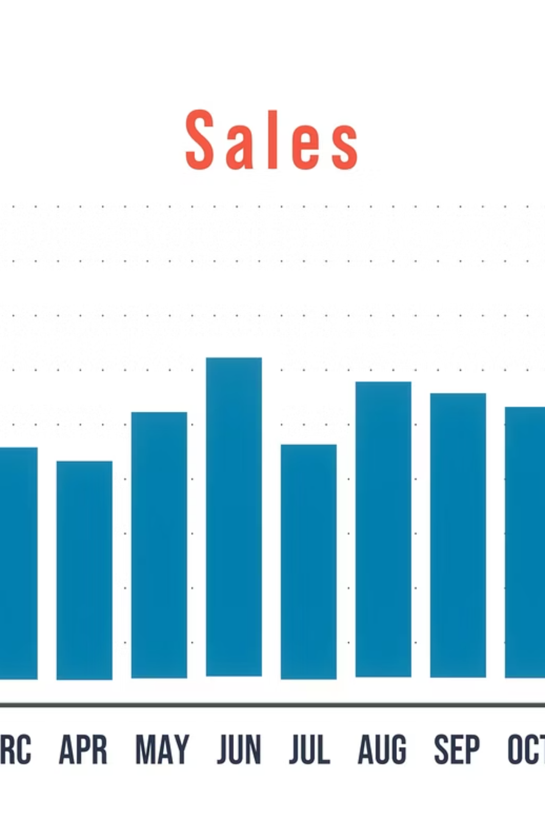
Business Intelligence & KPIs
Our system provides key performance indicators (KPIs) and trend analysis to help businesses make informed decisions and optimize their operations. Visualize your data for actionable insights.
12%
95%
3%
Orders Increasing
On-time Delivery Rate
Cancellations
Minimizing lost sales and improving customer retention.
Significant growth in monthly order volume, indicating market expansion.
High efficiency in meeting delivery deadlines, boosting customer satisfaction.

Slide 9

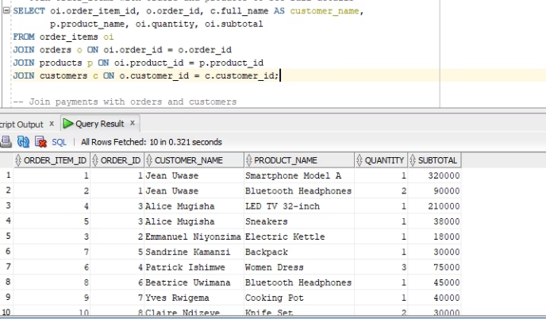
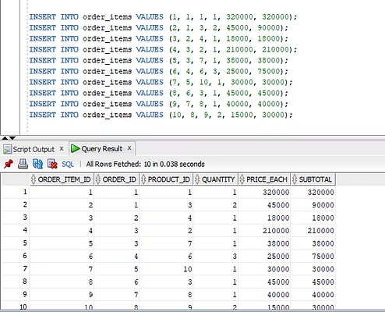
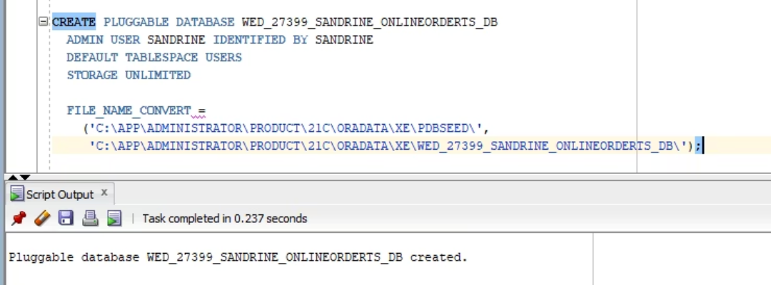
Results and Demonstration
DEMO
Achievements
Fully Automated System: A seamless, robust PL/SQL-driven platform.
8+ Core Tables: Comprehensive data storage for all aspects of order management.
10+ Functions, Procedures, and Packages: Extensive custom logic and reusable code for efficiency.
6+ Security & Automation Triggers: Ensuring data integrity and process automation.
BI-Ready Optimized Schema: Structured for immediate business intelligence integration.

Slide 10

Conclusion & Future Outlook
Key Achievements
Lessons Learned
Complete Automated Tracking: A fully functional system for end-to-end order visibility.
Importance of Normalization: Crucial for data consistency and efficiency.
Strong Database Integrity: Ensures accuracy, reliability, and security of all data.
Role of Triggers in Security: Essential for automated data validation and integrity.
Professional PL/SQL Implementation: Robust and efficient backend logic for seamless operations.
How Packages Simplify Large Systems: Enhances modularity and maintainability.
Usable Dashboards & KPIs: Provides clear insights for strategic decision-making.

